Slide 1
Segmentation, Segmentation with Paging, Virtual Memory Concept
(Operating System and System Programming)

Slide 2
The Content is prepared with the help of existing text books mentioned below:
Silberschatz, Abraham, Peter B. Galvin, and Greg Gagne. Operating system concepts with Java. Wiley Publishing, 2009.
Stallings, William. Operating Systems 5th Edition. Pearson Education India, 2006.
Tannenbaum, Andrew S. "Modern Operating Systems, 2009."

Slide 3
Segmentation
Memory-management scheme that supports user view of memory
A program is a collection of segments
A segment is a logical unit such as:
main program
procedure
function
method
object
local variables, global variables
common block
stack
symbol table
arrays

Slide 4
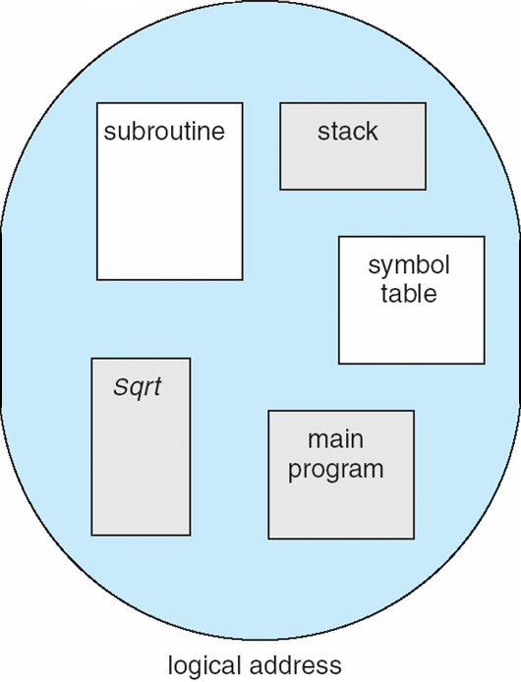
User’s View of a Program

Slide 5
Logical View of Segmentation
1
1
4
2
3
4
2
3
user space
physical memory space

Slide 6
Segmentation Architecture
Logical address consists of a two tuple:
<segment-number, offset>,
Segment table – maps two-dimensional physical addresses; each table entry has:
base – contains the starting physical address where the segments reside in memory
limit – specifies the length of the segment
Segment-table base register (STBR) points to the segment table’s location in memory
Segment-table length register (STLR) indicates number of segments used by a program;
segment number s is legal if s < STLR

Slide 7
Segmentation Architecture
Cont.
Protection
With each entry in segment table associate:
validation bit = 0 ⇒ illegal segment
read/write/execute privileges
Protection bits associated with segments; code sharing occurs at segment level
Since segments vary in length, memory allocation is a dynamic storage-allocation problem
A segmentation example is shown in the following diagram

Slide 8
Logical addressing in Segmentation
Segment Number
Logica Address space
Offset
The mapping of the logical address to the physical address is done with the help of the segment table.
Segment Limit | Segment Base | Other Bits

Slide 9
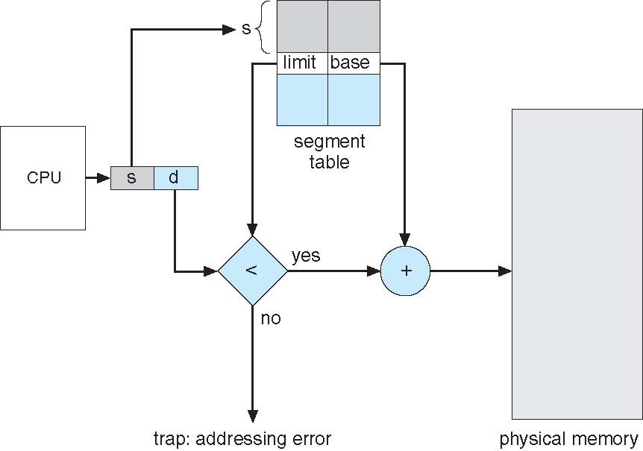
Segmentation Hardware
Cont.

Slide 10
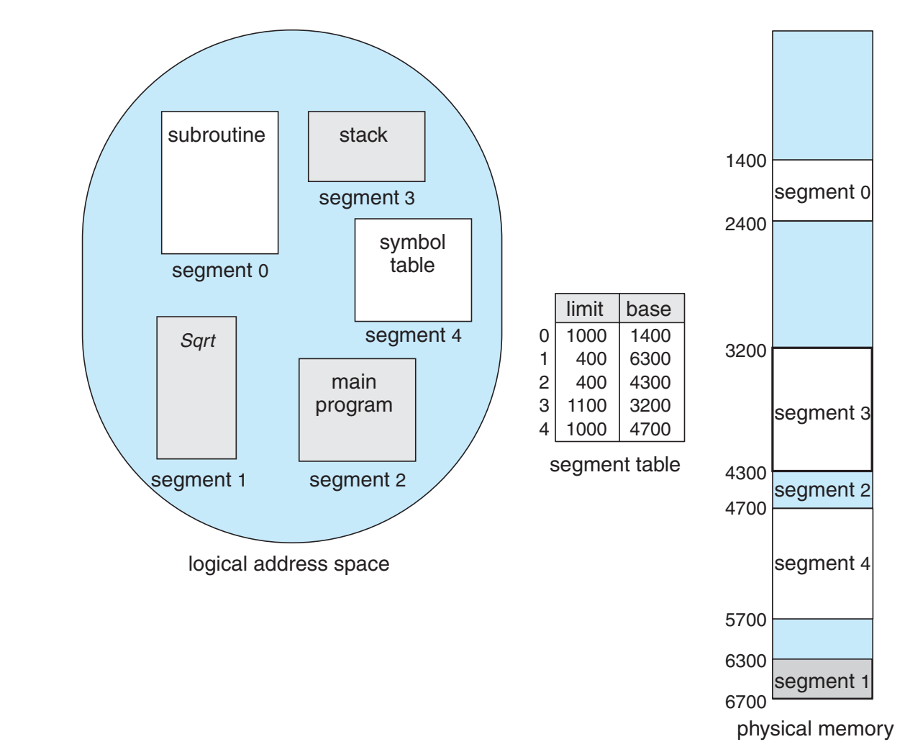
Example of Segmentation
Five Segments numbered from 0 to 4.
Segment are stored in physical memory.
Segment table has a separate entry for each segment.
Segment 2 is 400 bytes long and begins at location 4300.
A reference to byte 53 of segment 2 is 400 bytes long and begins at location 4300.
A reference to byte 53 of segment 2 is mapped onto location 4300+53=4353
A reference to segment3 byte 852 is mapped to 3200+852=4052

Slide 11
Advantages of Segmentation
No internal fragmentation
Segment tables consume less memory then page tables.
Because of the small segment table, memory reference is easy
Lends itself to sharing data among processes.
As the individual lines of a page do not form one logical unit, it is not possible to set a particular access right to a page.
Easier to grow and shrink individual segments
More efficient use of physical space

Slide 12
Disadvantages of Segmentation
External Fragmentation
Costly memory management algorithm
Unequal size of segments is not good in the case of swapping

Slide 13
Segmentation with Paging
Most architectures support segmentation and paging
Basic idea,
segments exist in virtual address space
base address in segment descriptor table is a virtual address
use paging mechanism to translate this virtual address into a physical address
Now an entire segment does not have to be in memory at one time
only the part of the segment that we need will be in memory

Slide 14
Segmentation with Paging
Paged segmentation is a memory management scheme which combines features of paging system and segmentation system .
User’s logical address space is divided into segments and each segment is divided into pages .
User specified his logical address with component
A Segment number
A Relative offset.
Paging hardware splits the offset into a page number and an offset within that page.

Slide 15
Segmentation with Paging
P0
P1
S0
P2
S0 : Segment 0
S1 : Segment 1
S2 : Segment 2
P0 : Page 0
P1 : Page 1
P2 : Page 2
P3 : Page 3
P3
P0
P1
S1
P2
P3
P0
P1
S2
P2
P3
Logical address space of one user process. Logical address space is divided into segments and segments and are divided into pages

Slide 16
Segmented Paging
Segment Map table
Page table base
Page table bound
Page table base
Page table bound
Page table base
Page table bound
Page Map Table
Seg #
Virt page #
Offset
+
Phy page #
Phy page #
Logical Address
Phy page #
>
Error

Slide 17
Segmented Paging
Seg #
Virt page #
Offset
Page table size
>
Phy page #
Phy page #
Phy page #
Phy page #
Offset
Error

Slide 18
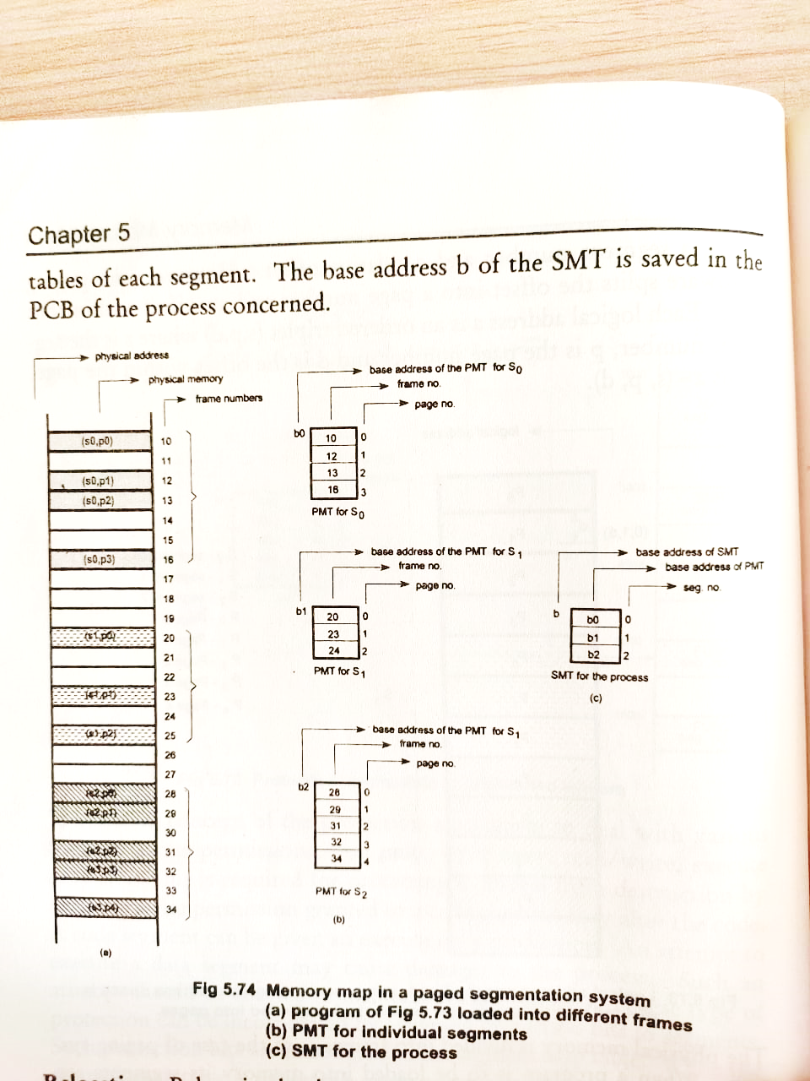
Segmented Paging

Slide 19
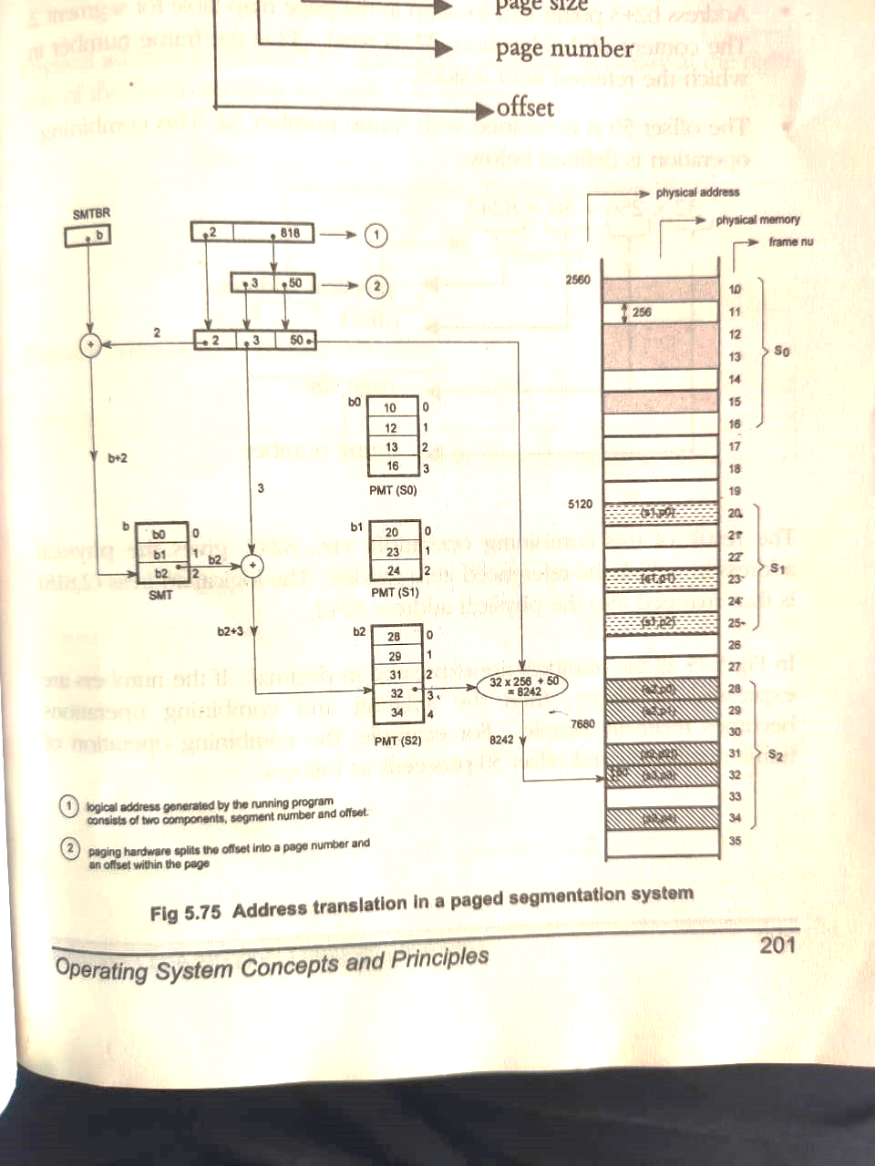
Segmented Paging

Slide 20
Segmented Paging Translation
Logical_address = segment_number:page_number:offset
page_table = segment_table[segment_number]
physical_page_number =page_table[page_number]
physical_address = physical_page_number:offset

Slide 21
Pros and Cons of Segmented Paging
+ Code sharing
+ Reduced memory requirements for page tables
- Higher overhead and complexity
- Page tables still need to be contiguous
- Each memory reference now takes two lookups

Slide 22
Virtual Memory

Slide 23
Objective
To describe the benefits of a virtual memory system
To explain the concepts of demand paging, page-replacement algorithms, allocation of page frames and thrashing.
To discuss the principle of the working-set model.

Slide 24
Background
In practice, most real processes do not need all their pages, or at least not all at once, for several reasons:
Arrays are often over-sized
Certain features of programs are rarely used.
The ability to load only the portions of processes that were actually needed has several benefits:
Programs could be written for a much larger address space.
more memory left for other programs, improving CPU utilization and system throughput.
Less I/O is needed for swapping processes in and out of RAM, speeding things up.

Slide 25
Virtual Memory Concept
Virtual Memory is a memory management scheme that supports the execution of partially loaded program.
Virtual memory allow the execution of a process whose logical address space exceeds far beyond the physically address ace available on the machine on which the program is being executed.
Virtual memory manager create an illusion that the physical memory is stretched far beyond the actual physical memory available on the machine.

Slide 26
Virtual Memory Concept
Code needs to be in memory to execute, but entire program rarely used
Error code, unusual routines, large data structures
Entire program code not needed at same time
Consider ability to execute partially-loaded program
Program no longer constrained by limits of physical memory
Each program takes less memory while running -> more programs run at the same time
Increased CPU utilization and throughput with no increase in response time or turnaround time
Less I/O needed to load or swap programs into memory -> each user program runs faster

Slide 27
Virtual Address Space
Virtual address space – logical view of how process is stored in memory
Usually start at address 0, contiguous addresses until end of space
Meanwhile, physical memory organized in page frames
MMU must map logical to physical
Virtual memory can be implemented via:
Demand paging
Demand segmentation

Slide 28
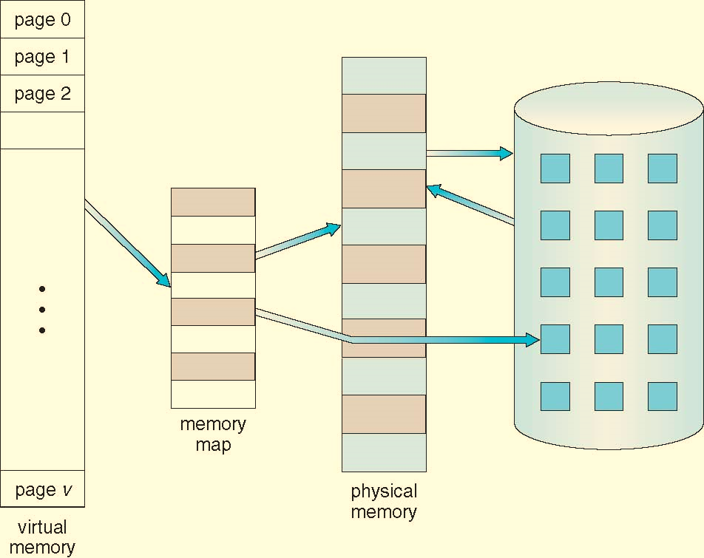
Virtual Memory That is Larger Than Physical Memory

Slide 29
Thanks

